Slide 1
Software Test Automation and System Design
Presenter: Kate Jordan

Slide 2
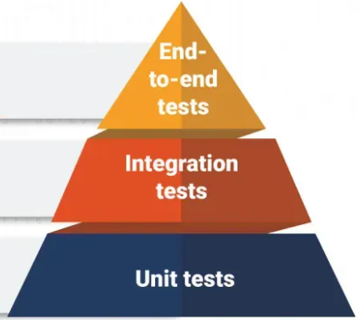
Testing Pyramid
Unit Tests: Assess a single variable and do not rely on external dependencies
Integration Tests: Involves integrating the various modules of an application and then testing their combined behavior.
End-to-End Tests: Automates testing from the end user's perspective, running through your application just like a user would.

Slide 3
Why do people resist automating tests?
Higher development cost when you initially write code
Any test you write you must maintain going forward
Introducing tests into systems that aren't designed for it is challenging and can be expensive

Slide 4
Why should we automate tests?
Testing, especially full system testing, is much faster if you don't have to do it manually
Provides rapid feedback loops to engineers when making changes
Improves system stability when making code changes
Provides documentation on how the system works
Leads to better system design and more maintainable code
Allows you to continue growing your codebase without having to add large numbers of manual testers

Slide 5
Unit Tests: Assess a single variable and do not rely on external dependencies

Slide 6
Unit Tests Example: Simple
Class PersonHelper
Method: string GetFormattedName(PersonInfo person)
Returns the full name, leaving out middle name and suffix if not present
Throws exception if first or last name is missing
Class PersonHelperTests :
Should have a test covering each possible combination of the names available in PersonInfo
Should also test exception causing cases, verify you get the expected exception

Slide 7
Unit Tests Example: Advanced
Class DocumentGenerator
Method: PrintDocumentForPerson(Document doc, PersonInfo person)
Creates a PersonHelper()
Adds the person's name into the Document using GetFormattedName()
Creates actual Printer() that it needs
Does Printer.Print(Document)
Class DocumentGeneratorTests:
I want to test that 1) the person's name populates into the document and 2) that the document is sent to the printer
Problem
Every time I run a test against PrintDocumentForPerson I'm triggering actual physical print
How do I test PrintDocumentForPerson without wasting paper?

Slide 8
Dependency Inversion
SOLID Design Principles
Dependency Inversion Principle:
The dependency inversion principle is a design principle that states that high-level modules should depend on abstractions rather than concrete implementations. This helps decouple the high-level and low-level modules, making it easier to change the low-level ones without affecting the high-level ones.
LogRocket

Slide 9
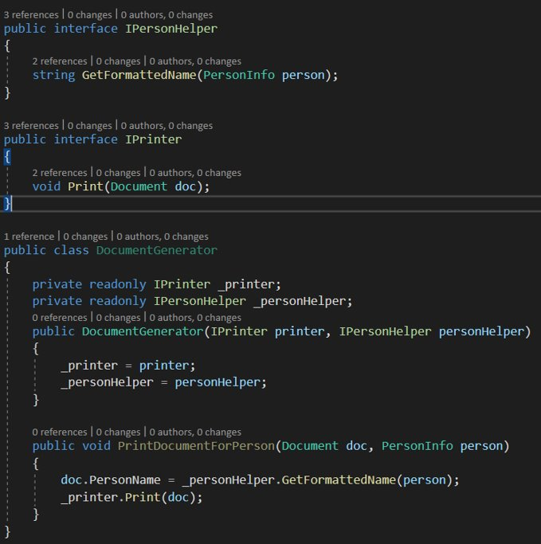
Applying Dependency Inversion
Create interfaces for each of DocumentGenerator's dependencies
Inject the dependencies into the class rather than creating them using concrete implementations
Use the Interface abstractions in PrintDocumentForPerson

Slide 10
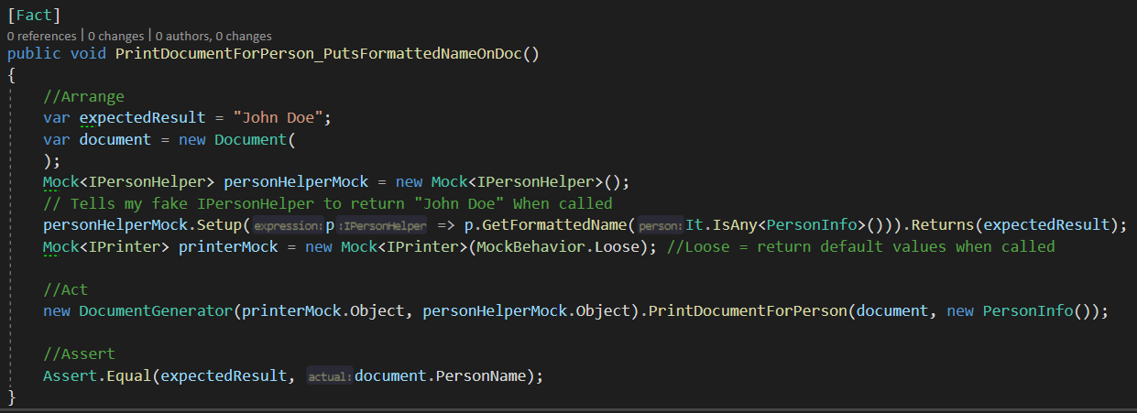
Applying this to Testing
We can now Mock our dependencies
In mock testing, we replace what our interfaces run with fake objects. We control how the fake object behaves in the test.

Slide 11
Broader Design Applications
Dependency Inversion and abstractions are key concepts when you begin looking at implementing Design Patterns
"Design patterns represent the best practices used by experienced object-oriented software developers. Design patterns are solutions to general problems that software developers faced during software development. These solutions were obtained by trial and error by numerous software developers over quite a substantial period of time."
Having a common, dependency injected interface makes it much easier to bring in new concrete implementations without extensive refactor. Example:
IPrinter starts with PhysicalPrinter
Request comes in to be able to print to PDF in some cases
PdfPrinter also uses IPrinter and you just inject the version you need to use. Code that uses IPrinter doesn't need to change

Slide 12
Integration Tests: Involves integrating the various modules of an application and then testing their combined behavior.

Slide 13
Integration Tests for APIs
Process for running an API integration test
Seed data for the test (insert/update API calls, Database inserts/setup)
Run the test, calling the API route(s) for your test case
Evaluate the results
Report results
Helpful Tooling
Swagger -> Gives developers a UI when building/testing API routes
Postman -> Lets you save HTTP requests and write tests to evaluate the response
Docker -> Allows you to make a temporary, isolated testing environment with seeded data

Slide 14
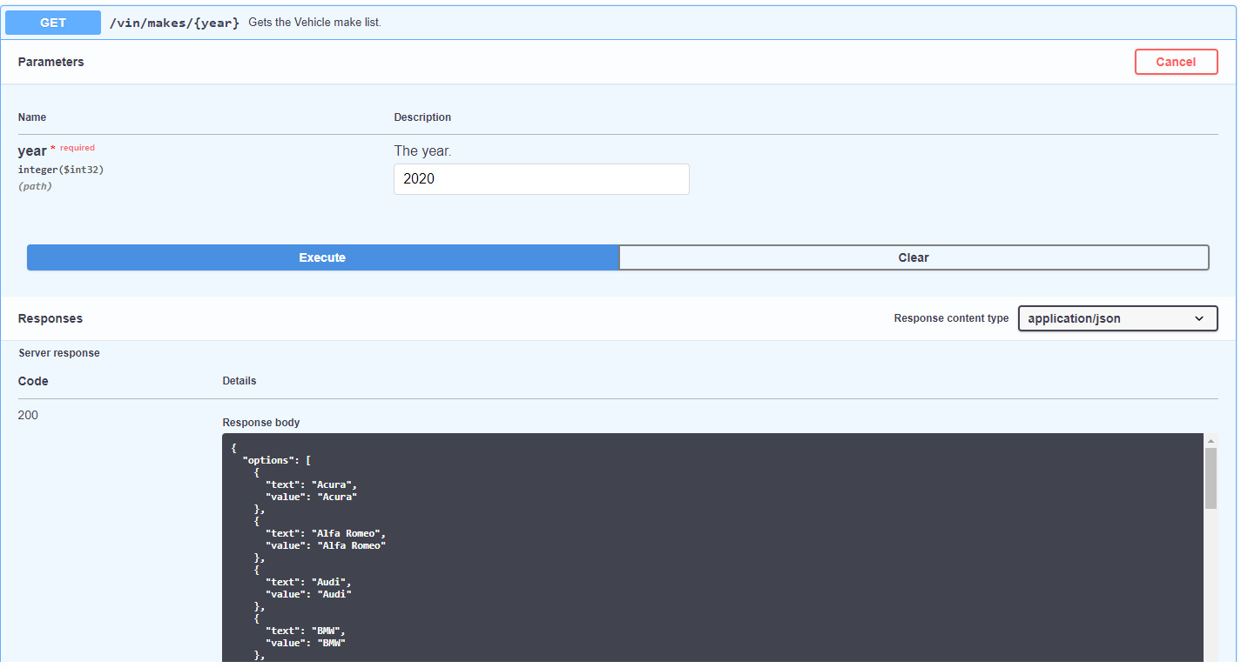
Swagger Example

Slide 15
Integration Testing Challenges
Integration tests truly hit your services, 3rd party dependencies, and your data
Must reset test data at the start of every run
Tests will be much slower to run than unit tests
Using external dependencies makes your code more likely to break as others make changes
Api routes that do many things or rely on calls to other APIs are more difficult to test
Typically require a lot of setup
Identifying what to write tests for is difficult

Slide 16
Design Decisions that can help
Microservice architecture
Smaller services with granular API routes
One Database per service
De-coupled communication between APIs using events
Messaging solutions (ex: Kafka)
If something doesn't have to happen right away, use a messages to queue up and handle them later
The simpler your individual API route is and the more it owns its own data and concerns, the easier it is to test. And the easier it is for engineers to maintain.

Slide 17
End-to-End Tests: Automates testing from the end user's perspective, running through your application just like a user would.

Slide 18
End-to-End Tests
End-to-End tests are both powerful and costly to run and maintain
Something as small as changing a button name can break these tests
Should be used to cover critical paths through your system and be limited in number
Don't overly rely on these and ignore Integration and Unit testing because End-to-End Tests can be set up without improving your architecture

Slide 19
Questions?

